Slide 1
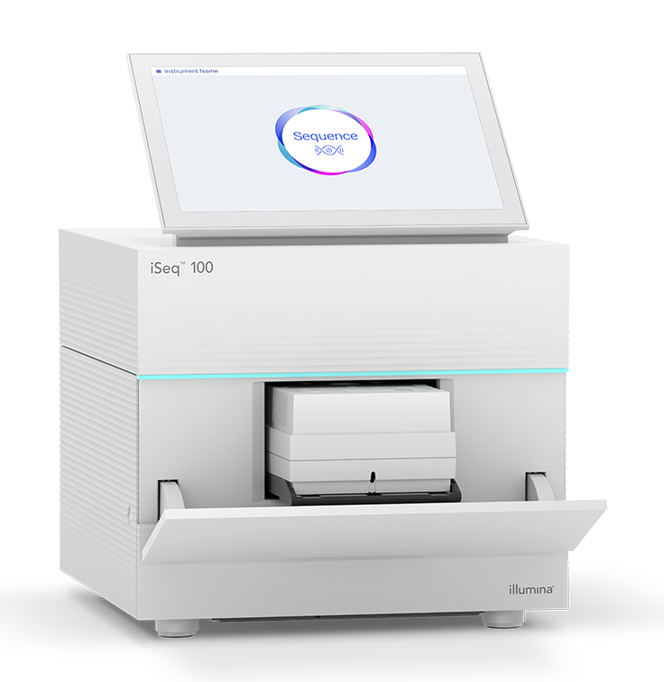
iSeq 100 Loading
A step-by-step guide
Rapid Response – Updated Jan 2026

Slide 2
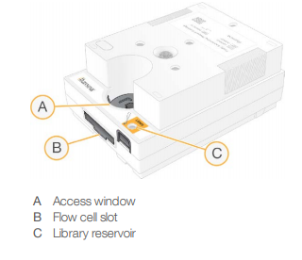
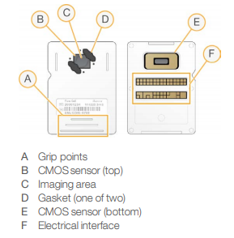
Before Loading...
Cartridge
Thaw Reagent Cartridge
  Overnight in 4ºC or
  6 hours in room temperature water bath
Take out flow cell from 4ºC
  At least 30 minutes before loading
Dilute library to loading concentration (75pM or optimized concentrations)
  Spike in 1% PhiX (default)
Invert the cartridge 5 times then tap gently on table
Insert flow cell into slot (B) in cartridge
Carefully pierce foil with a pipette tip. Do not touch bottom of loading well
Load 20µL of library into cartridge (C)
Flow cell

Slide 3

Notes:
Click on Sequence icon

Slide 4
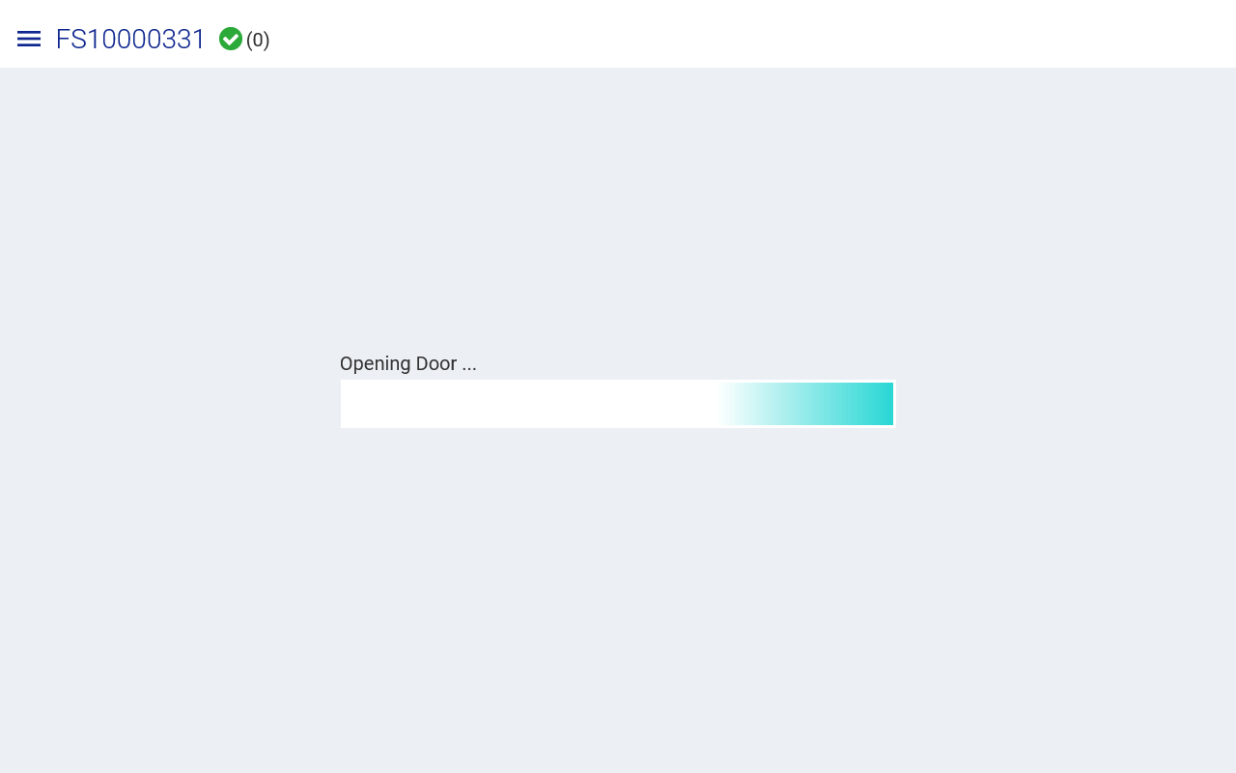
Notes:
The door will open so have the cartridge loaded

Slide 5
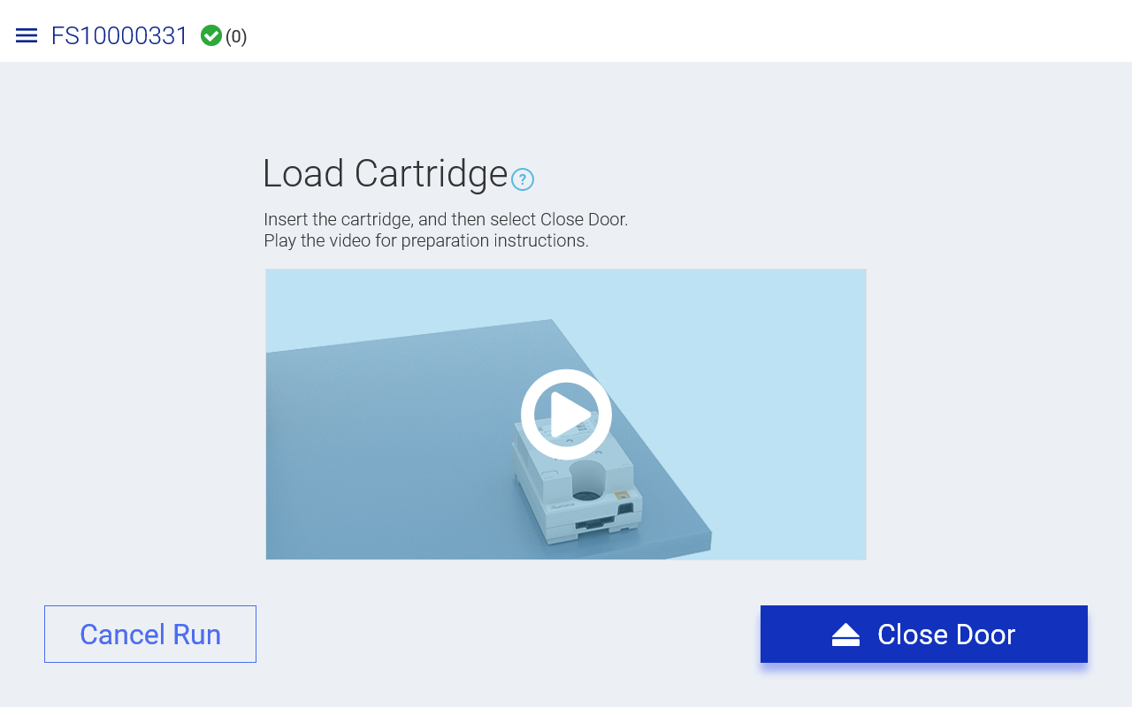
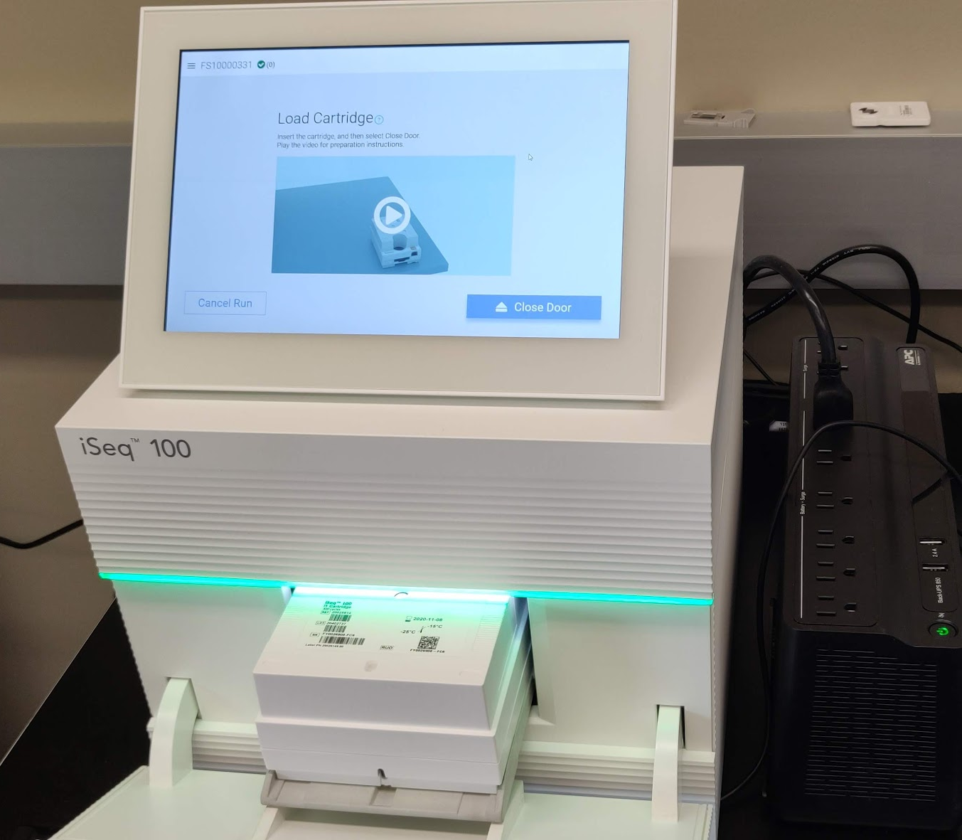

Slide 6
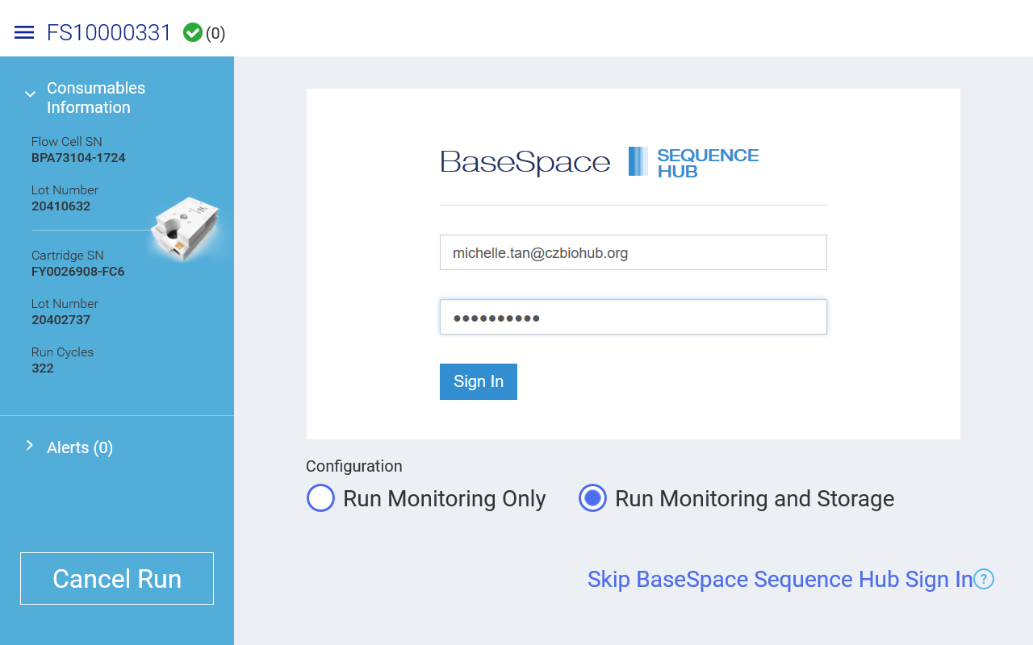

Slide 7
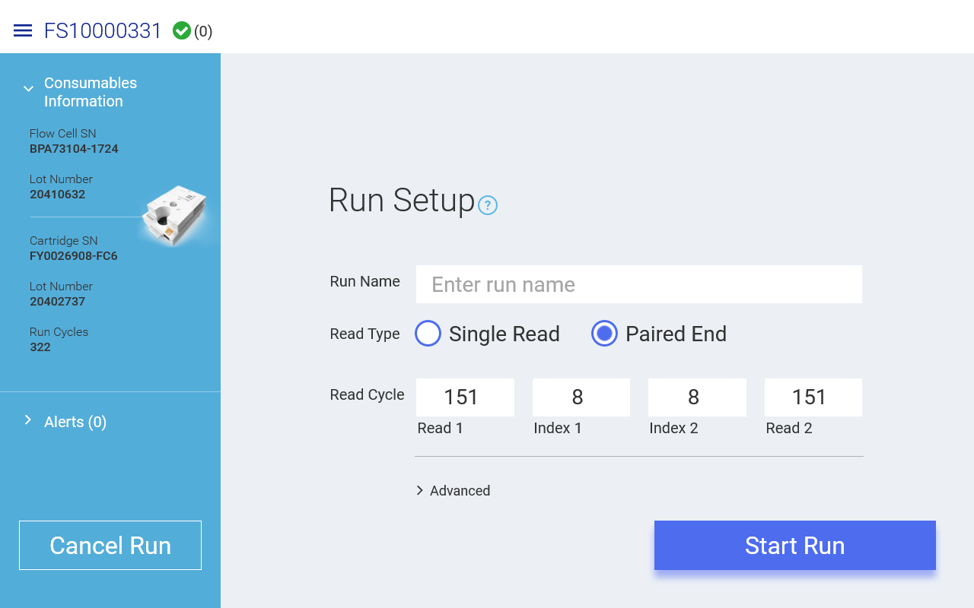
Notes:
Maximum number of cycles allowed is 322.

Slide 8
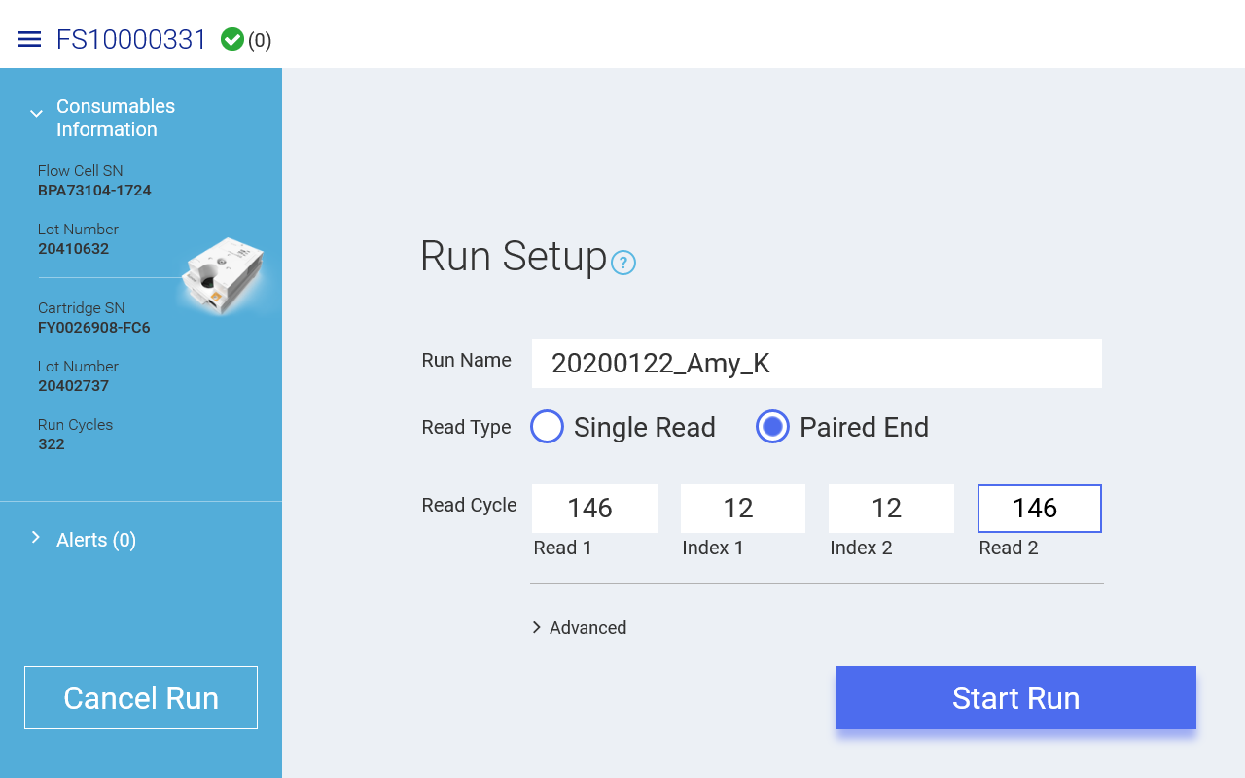

Slide 9
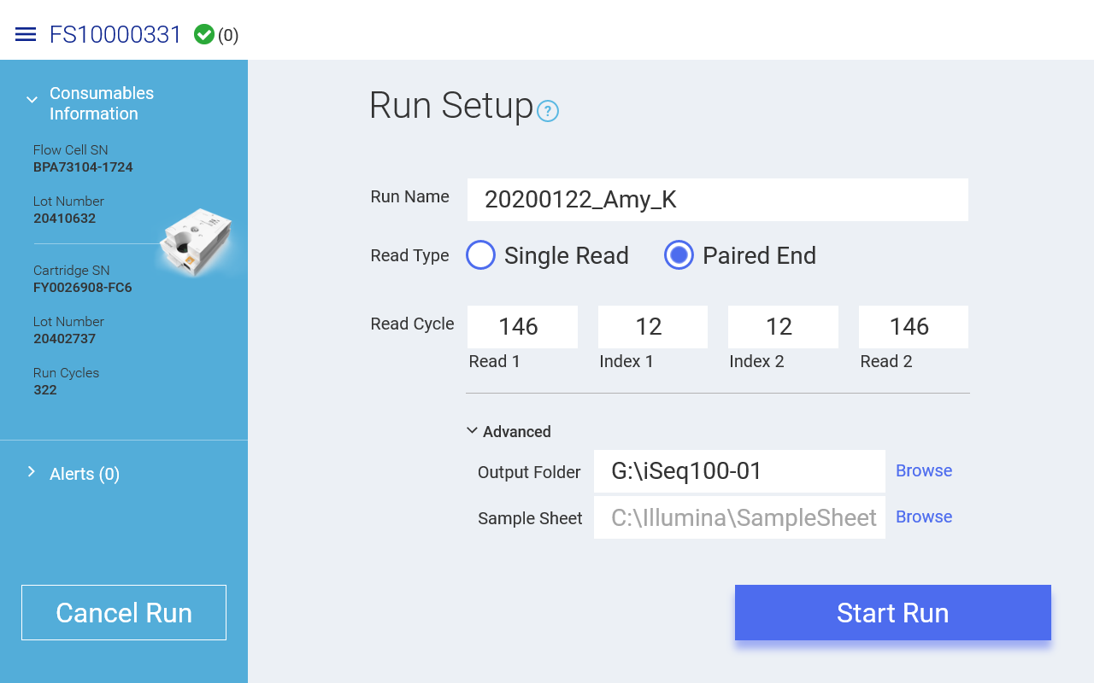
Notes:
Ours doesn't look like this

Slide 10
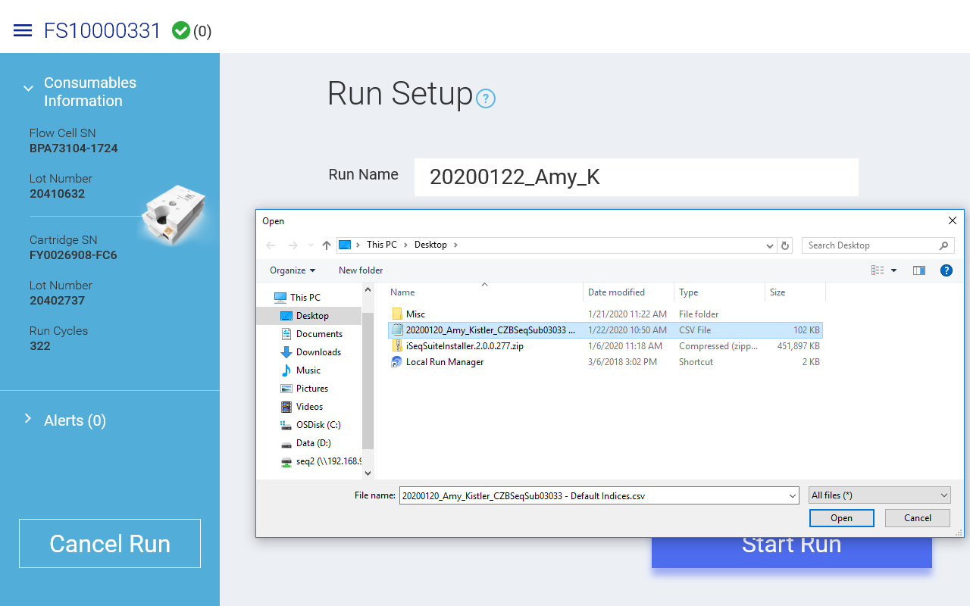
Refer to training presentation for samplesheet instructions.

Slide 11
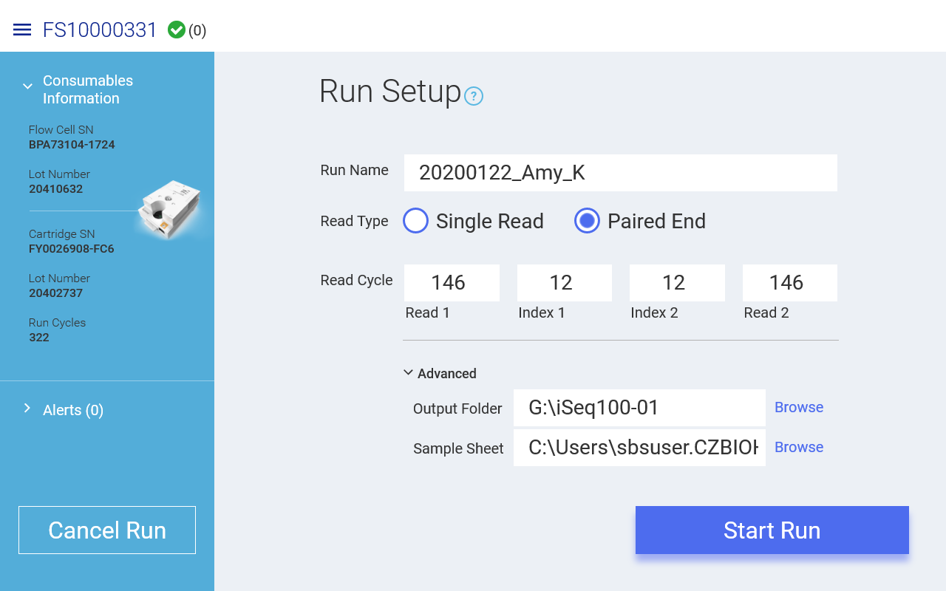

Slide 12
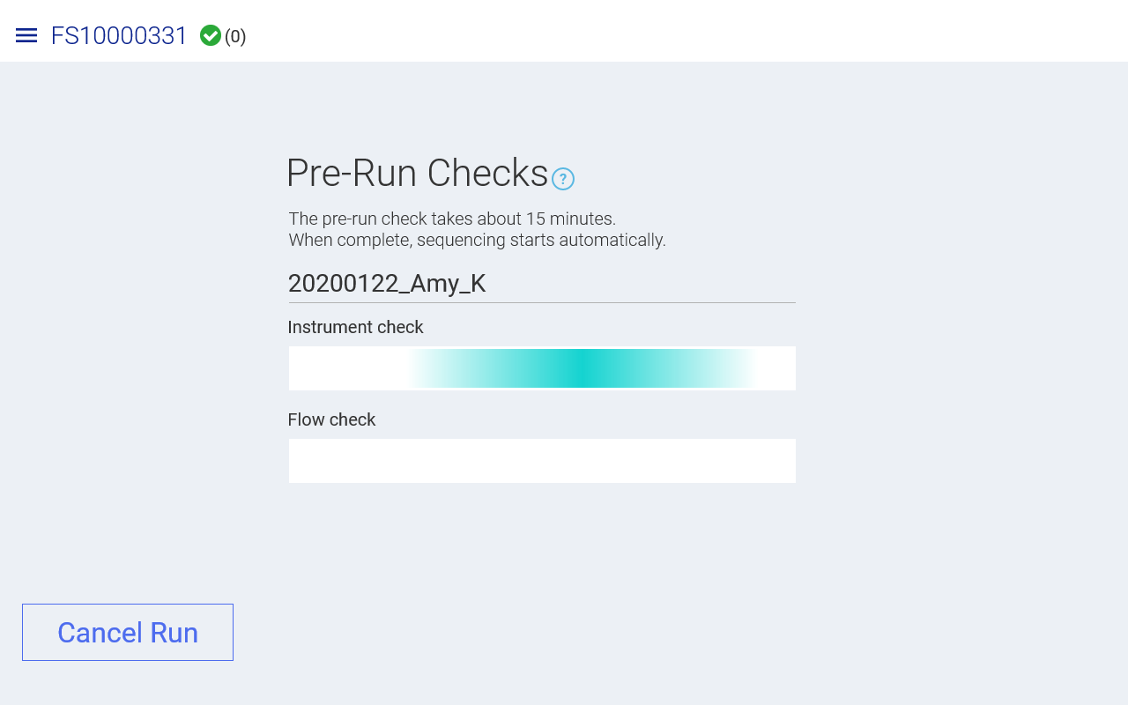
Pre-run checks will take ~15 minutes. Run starts automatically after the checks are completed.

Slide 13
iSeq Settings

Slide 14
iSeq settings and options

Slide 15
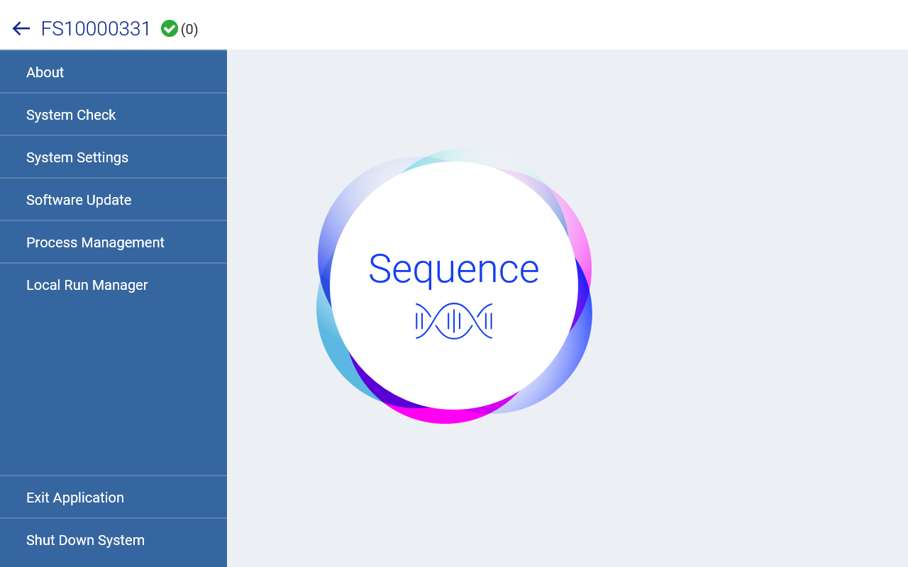

Slide 16
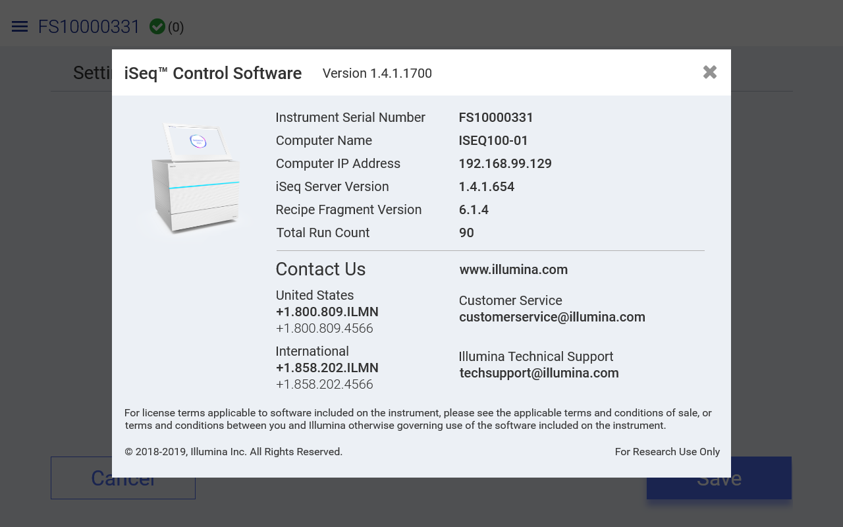
About
Notes:
Customer support by phone or email has quick turnaround time. Don’t hesitate to reach out if you run into any issues when loading, or if you need to troubleshoot a run.

Slide 17
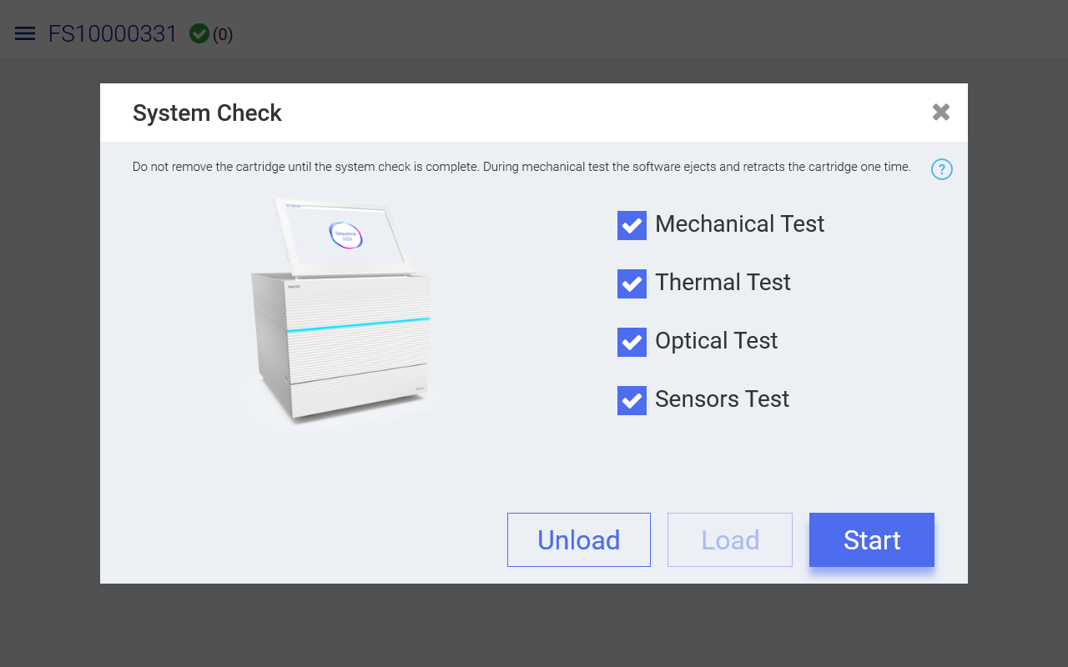
System Check:
Remember to put in system test cartridge + flow cell.

Slide 18
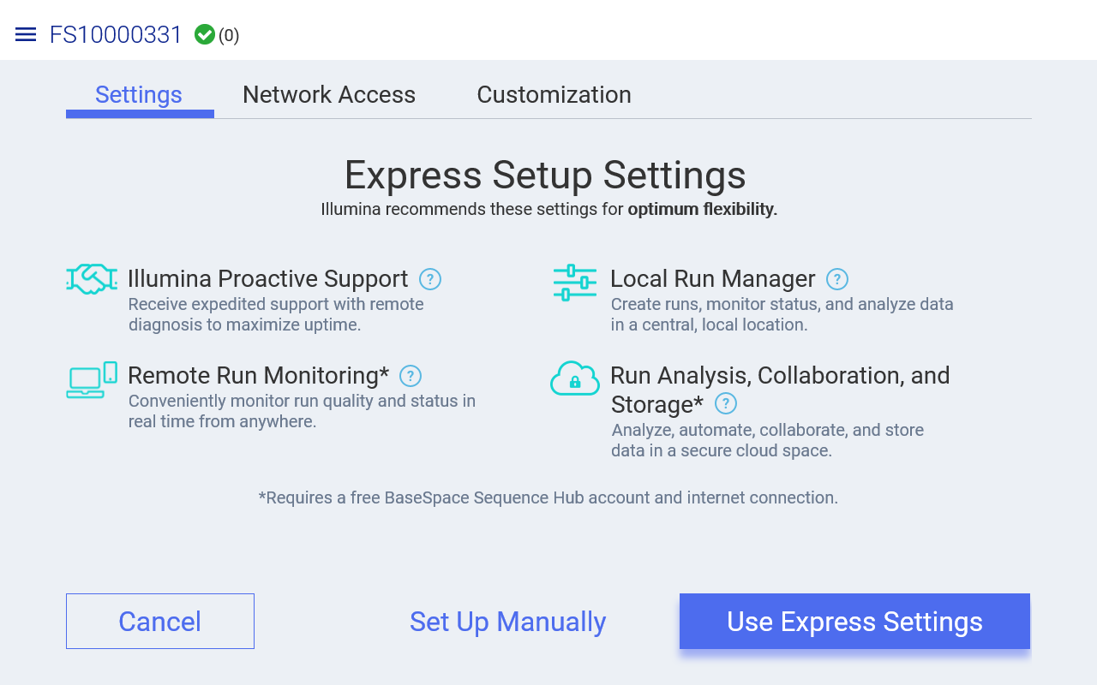
System Settings
Using Express Settings will use Local Run Manager to create runs. (Different from training)
To set up runs like we do in training, please select Set up Manually and in the Local Run Manager setting choose Use Manual Mode. (Next Slide)

Slide 19
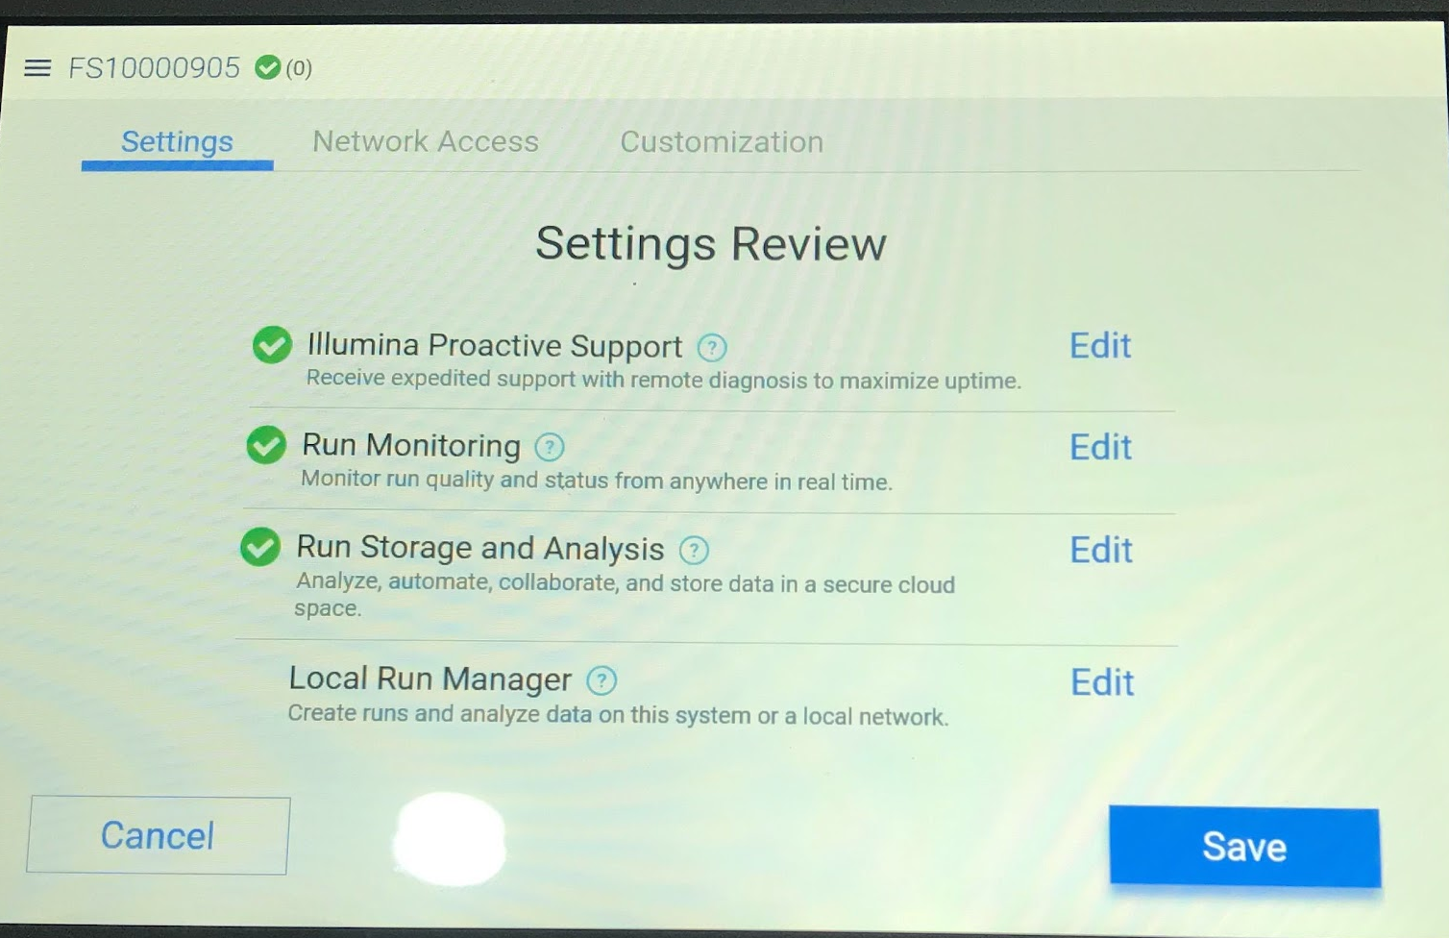
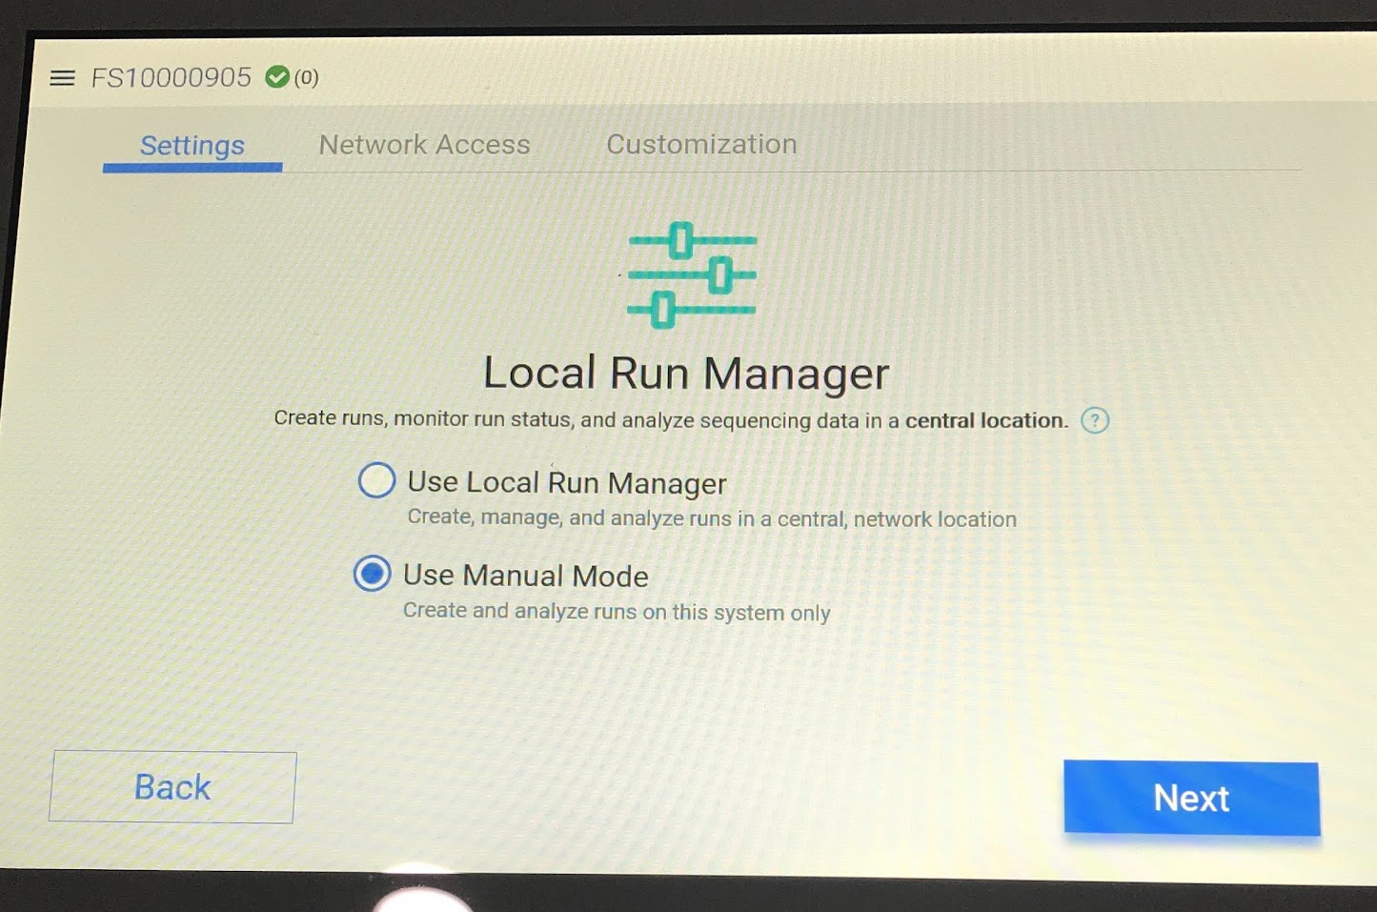

Slide 20
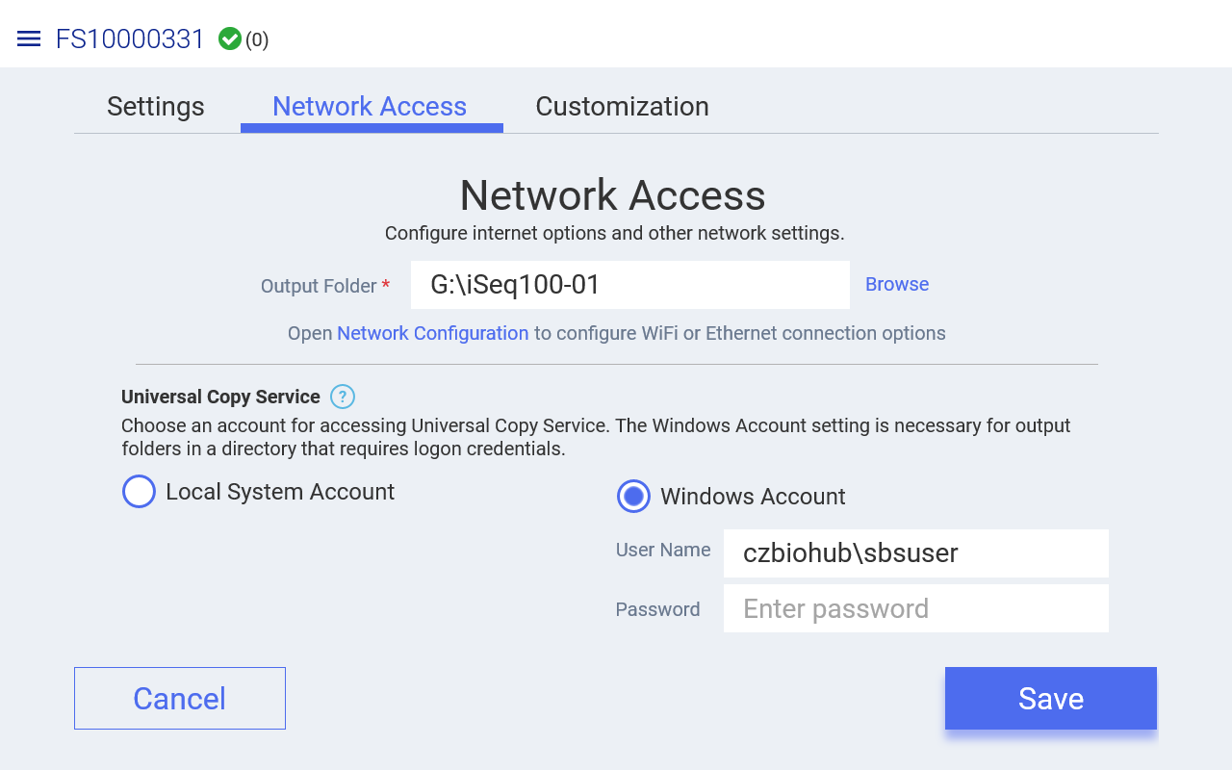
Set output folder to write to remote server or locally. Data is saved in two places, one copy in the output folder (defined here) and another in the local drive.

Slide 21
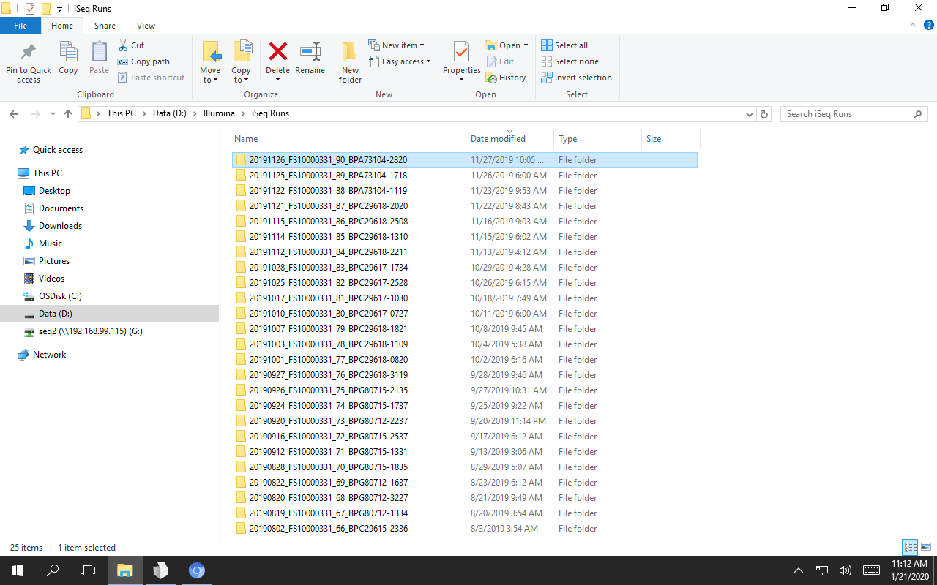
Local copy on computer. Our sequencer also writes to our remote server.

Slide 22
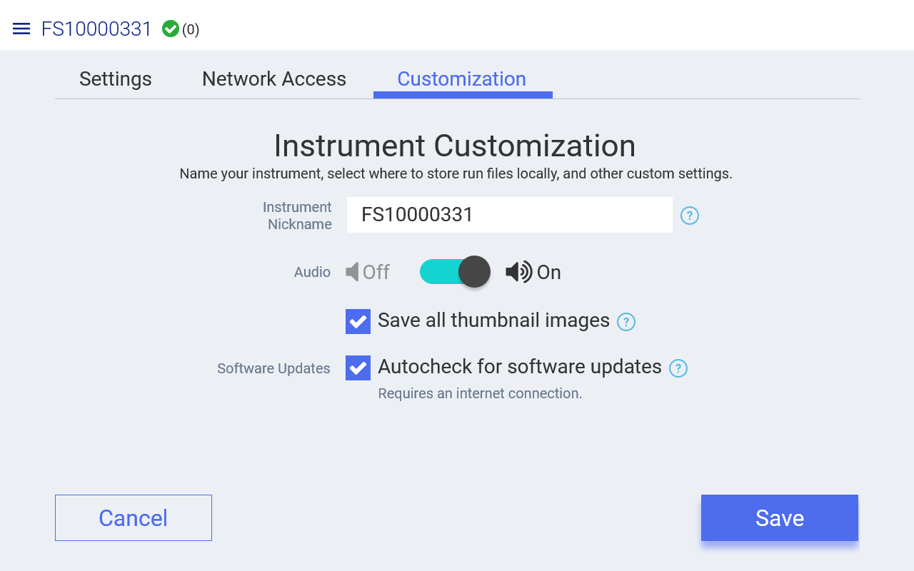

Slide 24
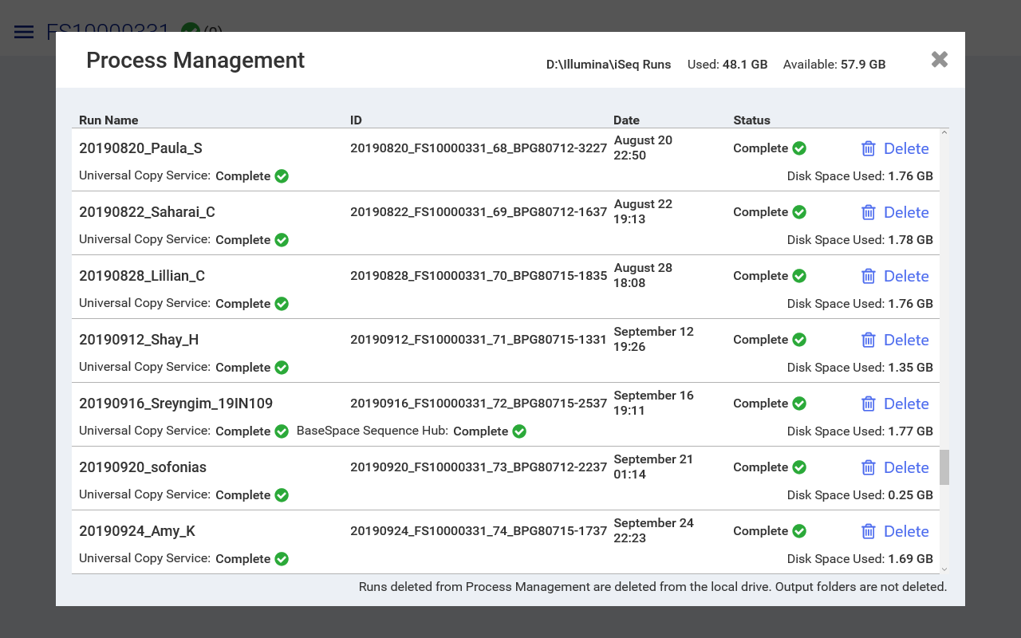
Process Management:
Can delete runs here if your computer is running out of disk space
Notes:
What about adding the systems control software _ ask vida I’m forgetting the name of what vida downloaded for us to view the runs viewer?

Slide 25
Next: 08-I_Sequencing Run QC for Illumina – Slides & Activity

